Slide 1
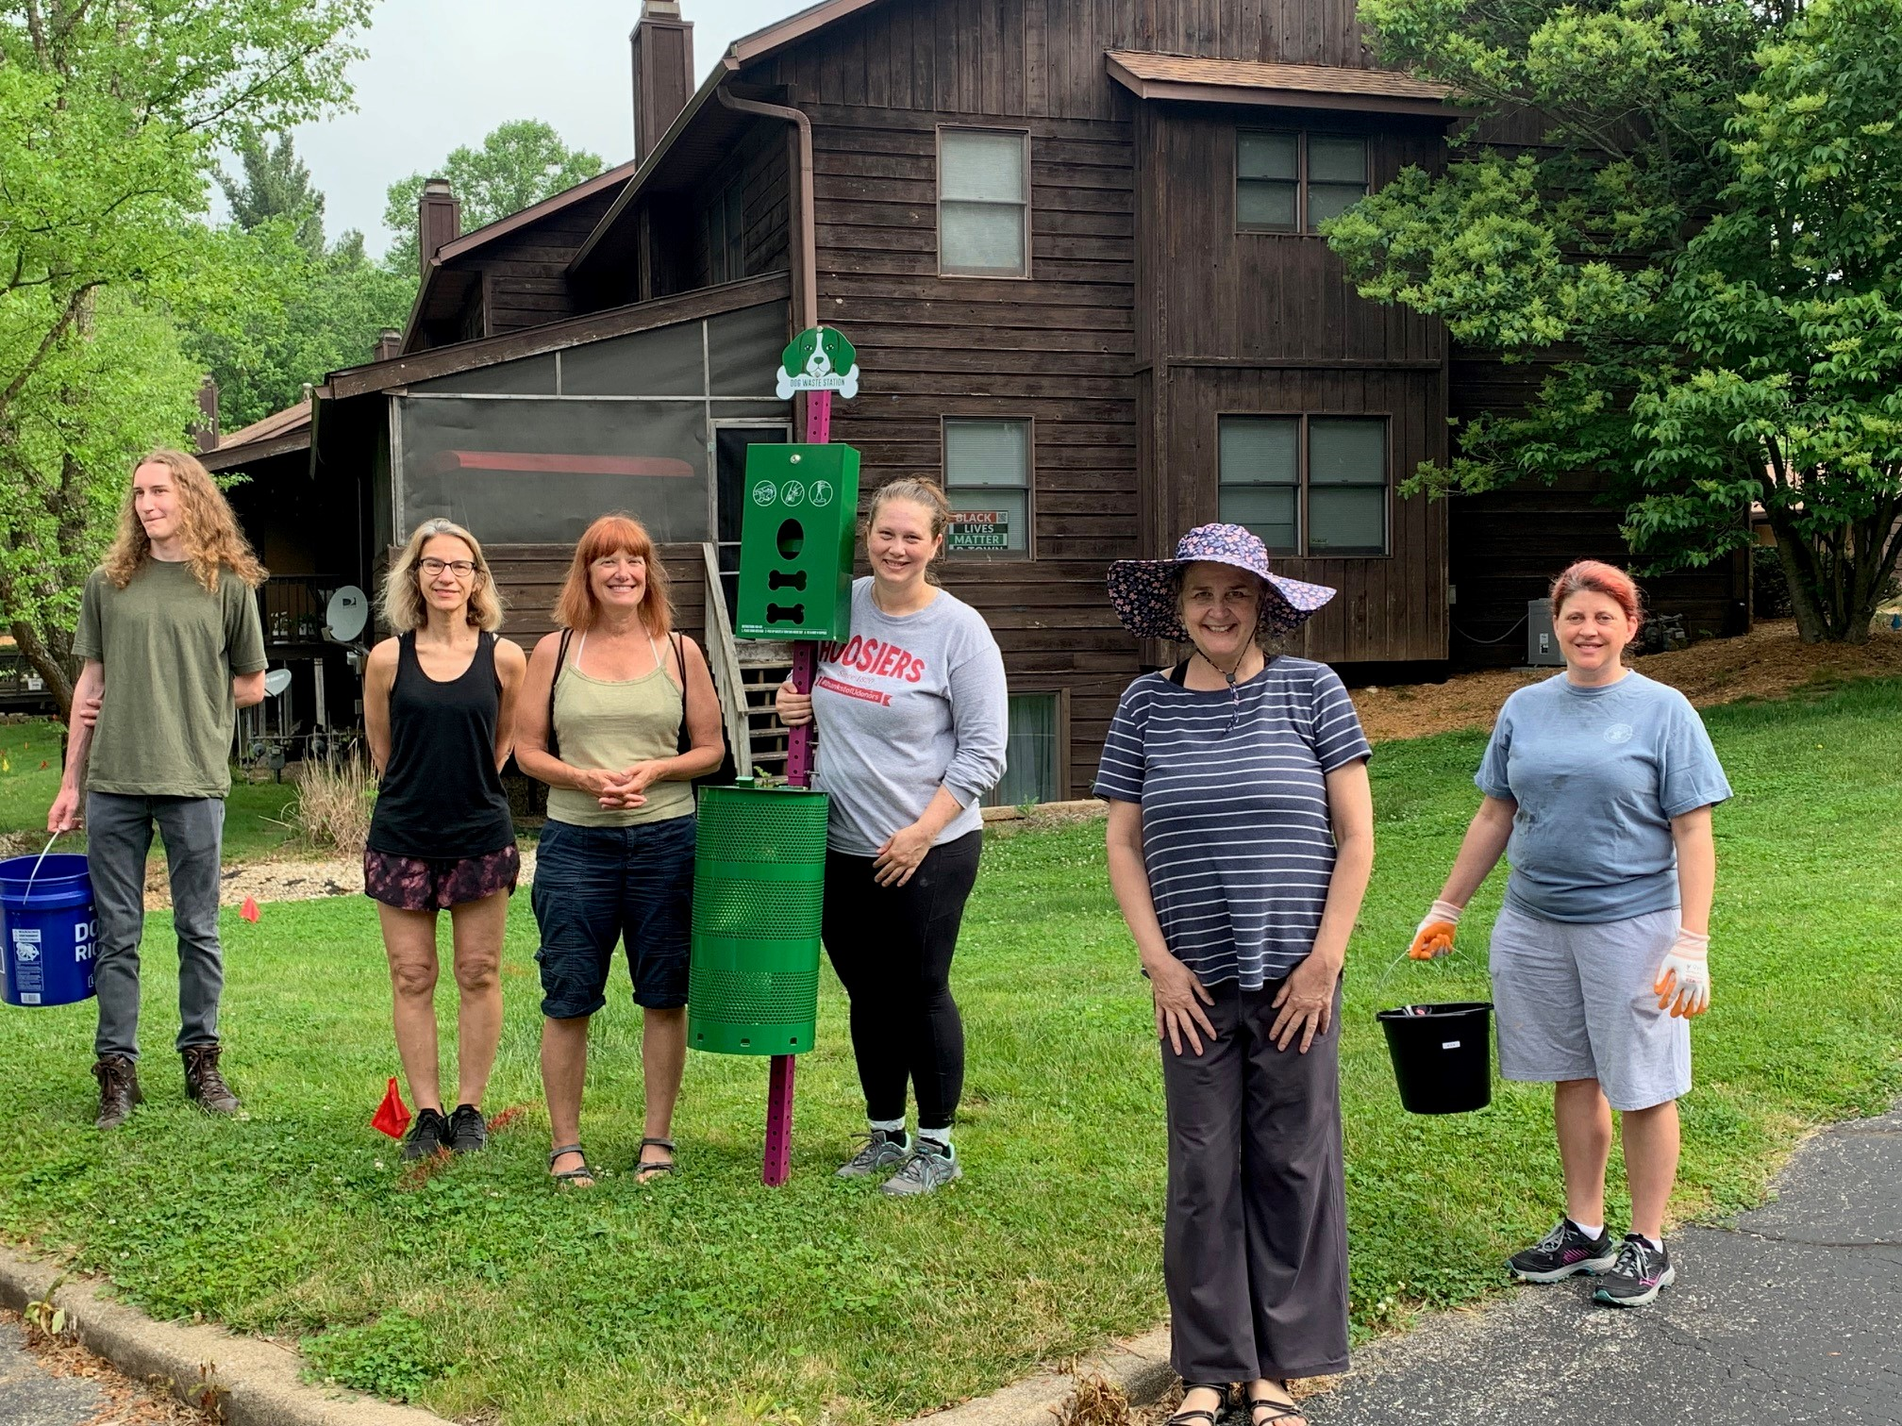
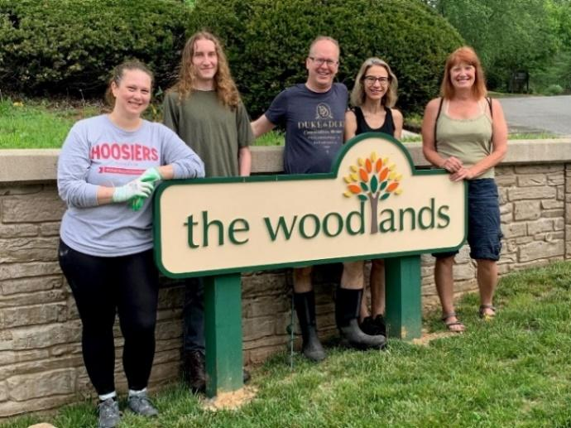
Board members:
Kris Kunts: President & Treasurer
Cathy Brown: Vice-President
Li Meuser: Secretary
Valerie Grim: At-large board member
Jeanette Clausen: At-large board member
Website: woodlandshoa.net
HOA Request Page: woodlandshoa.net/hoa-requests
(Must be used for all communications and requests)
Q3 Summer Newsletter 2024
“I can feel a sunshine stealing into my soul and making it all summer, and every thorn, a rose.” ~ Emily Dickinson
Yearly Repair Schedule:
Plan for upcoming repair need and costs
Reduce budget expenditures whenever possible
Reduce neighborhood conflicts & build community
Repair the drainage basin (prior obsolete pond area)
Drainage work project: Foundation & Ground drainage
Check the Yearly Maintenance Schedule (YMS) on The Woodlands website & Homeowner Google Drive (HGD) for updates
2024 Regular External Maintenance Work:
March-December Landscaping completes many tasks to maintain the grounds & safety of the buildings.
Cedar mulch is placed in the fronts of units & common areas in the spring to deter insects & prevent erosion.
Regular mowing of the grass spring through fall
Bush trimming in the spring and fall
Leaf blowing in the fall (fronts/sides of units, common areas and streets/sidewalks, leaves mulched in the rear)
Branch removal once per month, tree trimming in the fall.
Yearly tree assessment in May (Tree injections in June)
Bluestone tree conducts woody invasive management four times per year, to remove vines/bushes/trees and stray trees that start to grow too close to buildings
Gutter cleaning & wood chip trail management spring/fall
Chimney inspections occur in the fall.
Herbaceous invasive management in progress
Snow/Ice removal services as needed (2+ inches for snow)
2023 Community Volunteer Day
Resources: All found on The Woodlands website
Yearly Maintenance Schedule (YMS)
Welcome Packet
Rules & Regulations / Governing Documents
Operations Manual
We need your help! Volunteers are needed for:
The spring neighborhood garage sale
The Fall Community Volunteer Day
Grant Applications & Other volunteer projects
Join a Committee or serve a term on the board!
Put in an HOA Request on the website if you have any interest in volunteering & check the email updates for information!
HOA Fee Payments:
The Woodlands fees due:
Monthly HOA fees on the 1st of each month
External insurance by January & June
Any special assessments ~ none in 2024
All fees can be paid online or by mail-in check. To pay online, go to The Woodlands website ‘payment’ tab. Please check the governing documents section of the website for rules regarding payments.
Put in an HOA Request to receive email updates and to have access to the Homeowner Google Drive (documents)!

Slide 2
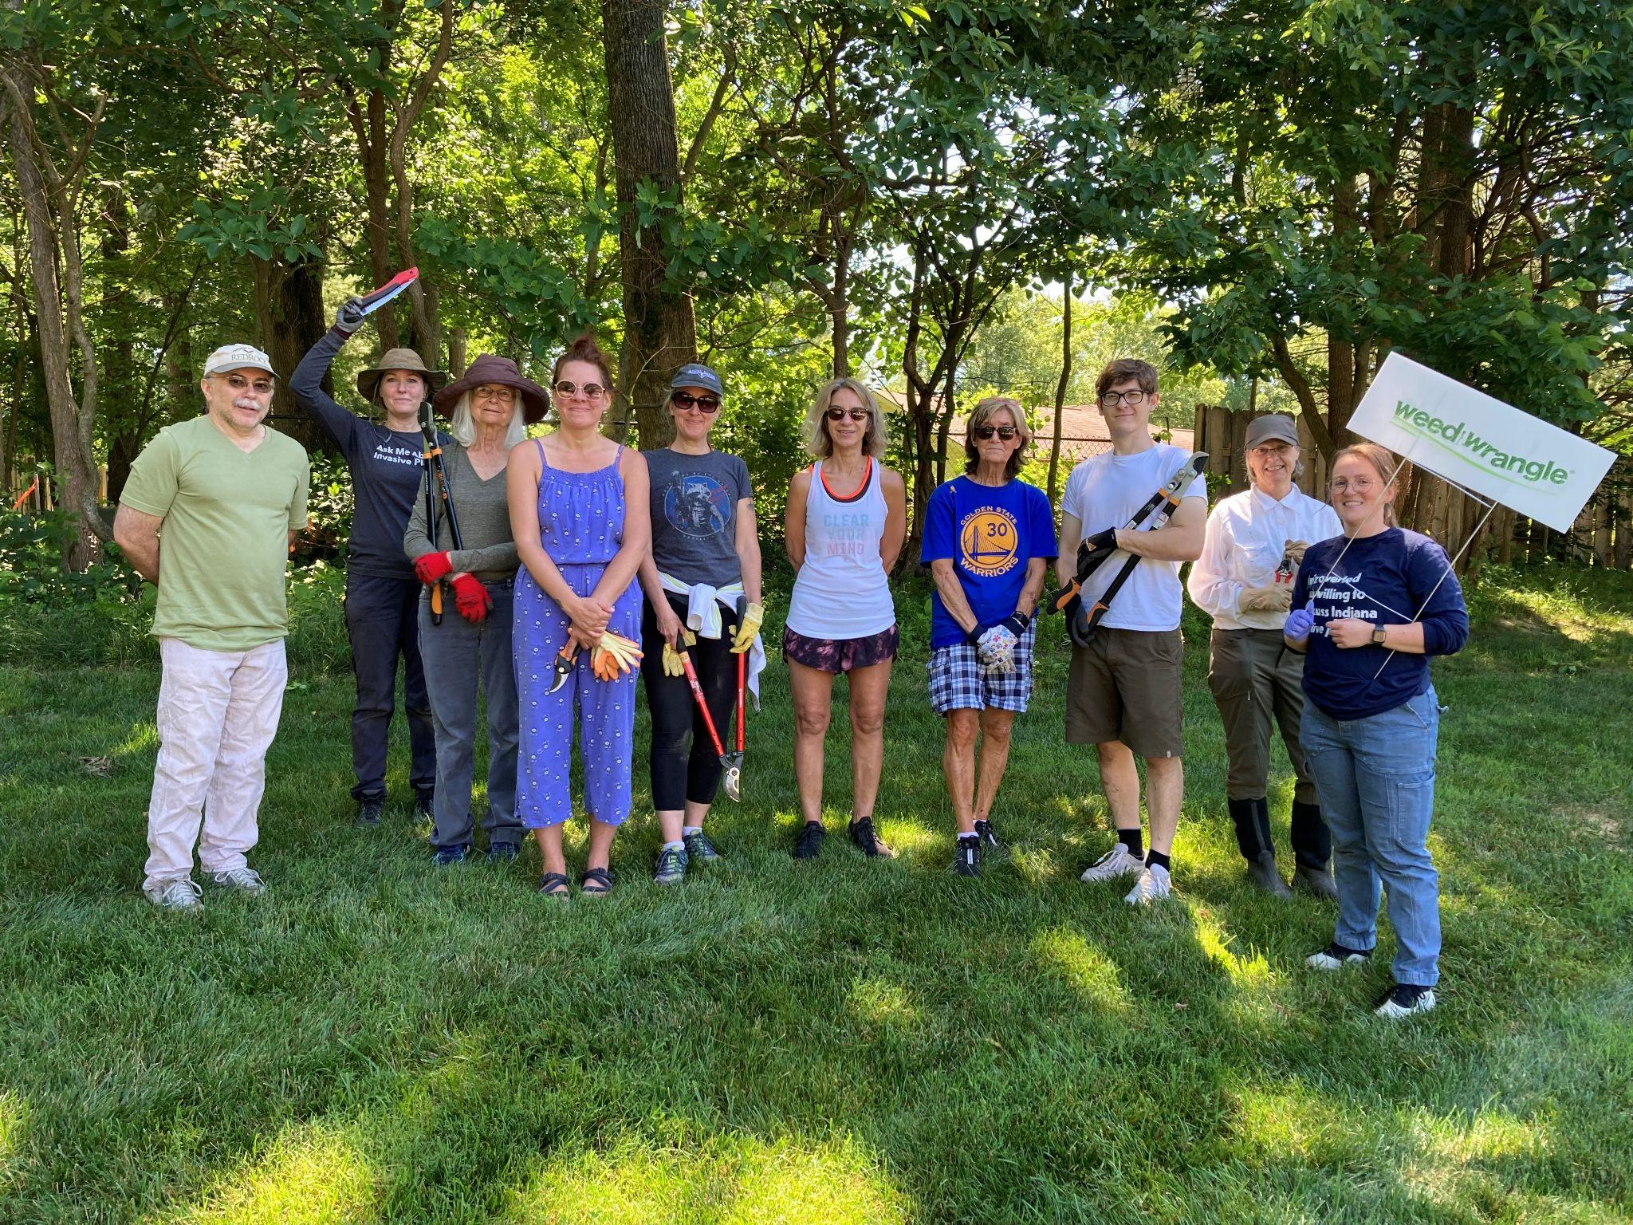
Board Elections:Please consider running for the HOA board!
October fall 2024 elections for 3 open board seats with 3-year terms.
Each unit gets one vote. The voting is standard mail in ballot process. A fair system with ample time to vote.
Candidate nominations are submitted on the ‘Get Involved’ section of the website www.woodlandshoa.net
Sept. 1: Candidate statements due, Nov. 1 Ballots due
Please check the website, Homeowner Google Drive and email announcements regularly for updates on elections.
HOA Board Project Updates:
Board members prioritize their legal obligations first: Approve invoices, provide meeting agenda/minutes, attend HOA meetings, vote on items, internal quarterly audits, budget approval, legal cases, arrearages and more.
The welcome packet was created and is now on the website and is mailed out to new homeowners by the PM
Volunteer weeding is still occurring, until herbaceous invasive management is established with Deep Roots.
Updating the Rules & Regulation Document
Creating an Operations Manual
Homeowner Survey Results Report
ADA compliant Governing Documents
Homeowner Feedback Survey:
Please take the homeowner feedback survey quarterly.
Please go to the website under ‘Get Involved’ to fill out this survey when it gets close to the end of a quarter (March/June/September)
Homeowner Feedback Survey results will be put on the Homeowner Google Drive if board members have time to generate a report and discussed at town hall meetings.
Woodlands Rules & Regulations
Please familiarize yourself with The Woodlands rules on
our website: rules and regulations doc (Found at the top of
our website under Governing Documents:
woodlandshoa.net). These rules help keep our
neighborhood clean, safe and protect everyone’s property
values. Property Management Jamar conducts quarterly in-depth walk arounds the neighborhood to find any rule violations and help them get corrected to keep everyone safe.
Upcoming board meetings: All meetings held on zoom
Monthly Open Board Meetings 7-8:30pm
Held on the 2nd Thursday of each month (No Dec)
Quarterly Town Hall Meeting 7-8:30pm
Held on the 3nd Thursday of each quarter (No Dec)
Annual Meeting 7-8:30pm
Held on the 2nd Thursday of the year in October
Zoom Link: https://zoom.us/j/9202320239
Meeting ID: 9202320239 ~ no passcode
2022 Community Volunteer Day
Current Committees:
We welcome your spirit of collaboration and community involvement! The goal of our neighborhood committees is to improve safety, transparency, and fiscal responsibility in The Woodlands community. If you are interested in joining one of these active committees, please submit an HOA request on our website. We also welcome any help finding funding for our many projects!
Finance Committee
Buildings Committee
Grounds Committee
Outreach Committee
Correct Procedures: HOA Requests
All HOA requests and communication must go through the HOA request page on the website.
Including: maintenance, financial, documents, etc.
Requests can be submitted on a computer or phone.
Call Jamar Property Management if you need help.
Dispute Resolution Process: Individuals may ask the HOA for a meeting if you feel that your request has not been resolved. Please do this before moving to legal action, as legal action costs all homeowners money and puts our insurance at risk.
Woodland Happenings:
Q3/Summer at The Woodlands’ repair of the drainage basin should run from August through October.
Q4/Fall at The Woodlands yearly fall community volunteer day is on September 14th from 10am-12pm, coordinated by the Grounds Committee. Meet at the HOA garage (near the entrance of the neighborhood) shortly before 10am. Planting, weeding and general improvement of the neighborhood will take place! A pitch-in meal will happen at the pond deck at 12pm following the event. Please put in an HOA Request if you have any specific questions about these upcoming events.
-Your WWBHOA board
The Woodlands Winding Brook Homeowners Association

